Slide 1
Westbound: Latvia's Strategic Shift in Economy, Logistics, and Transport
Kaspars Briškens Minister of Transport of the Republic of Latvia
American Chamber of Commerce in Latvia, 7th June 2024

Slide 2
AVIATION
STRATEGIC INDUSTRY FOR LATVIA
RIGA AIRPORT – A REGIONAL LEADER
880M IN EXPORTS
70+ DIRECT DESTINATIONS
2024 Q1: 26% INCREASE IN REVENUE, 20% INCREASE IN PASSENGER NUMBERS
FUTURE IPO

Slide 3
LEADING THE WAY: AIRBALTIC IN CAPITAL MARKETS AND AVIATION DEVELOPMENT
airBaltic successfully issued €340 million in bonds;
Issue of 14.50% senior secured bonds with a 5.25-year term;
Largest corporate bond issue from Latvia;
Over 100 global institutional investors from 20+ countries across 3 continents;
Demand exceeded EUR 800 million.
Successful bond issue demonstrates investor confidence, paving the way for a potential airBaltic IPO earliest in the second half of 2024.

Slide 4
DIRECT AIR CONNECTIVITY
Top Destinations 2023
Destination | O&D PAX
New York | 17 338
Toronto | 6 960
Chicago | 6 695
Boston | 6 392
Washington | 5 605
Los Angeles | 5 572
Miami | 5 257
Ottawa | 3 808
San Francisco | 3 350
Orlando | 3 336
RIX-USA & Canada O&D Traffic
Two-way traffic, TPPA
Notes:
RIX Riga Airport is meeting airlines and inviting carriers to fly to Riga on regular basis as New York is on top of unserved destinations from Riga!
Current passenger/cargo demand is a high risk investment for airlines. Right aircraft type and airline cooperation needed to secure connectivity.
To support the business case, a survey of AMCHAM members is planned in June to identify potential commitment from the business community.

Slide 5
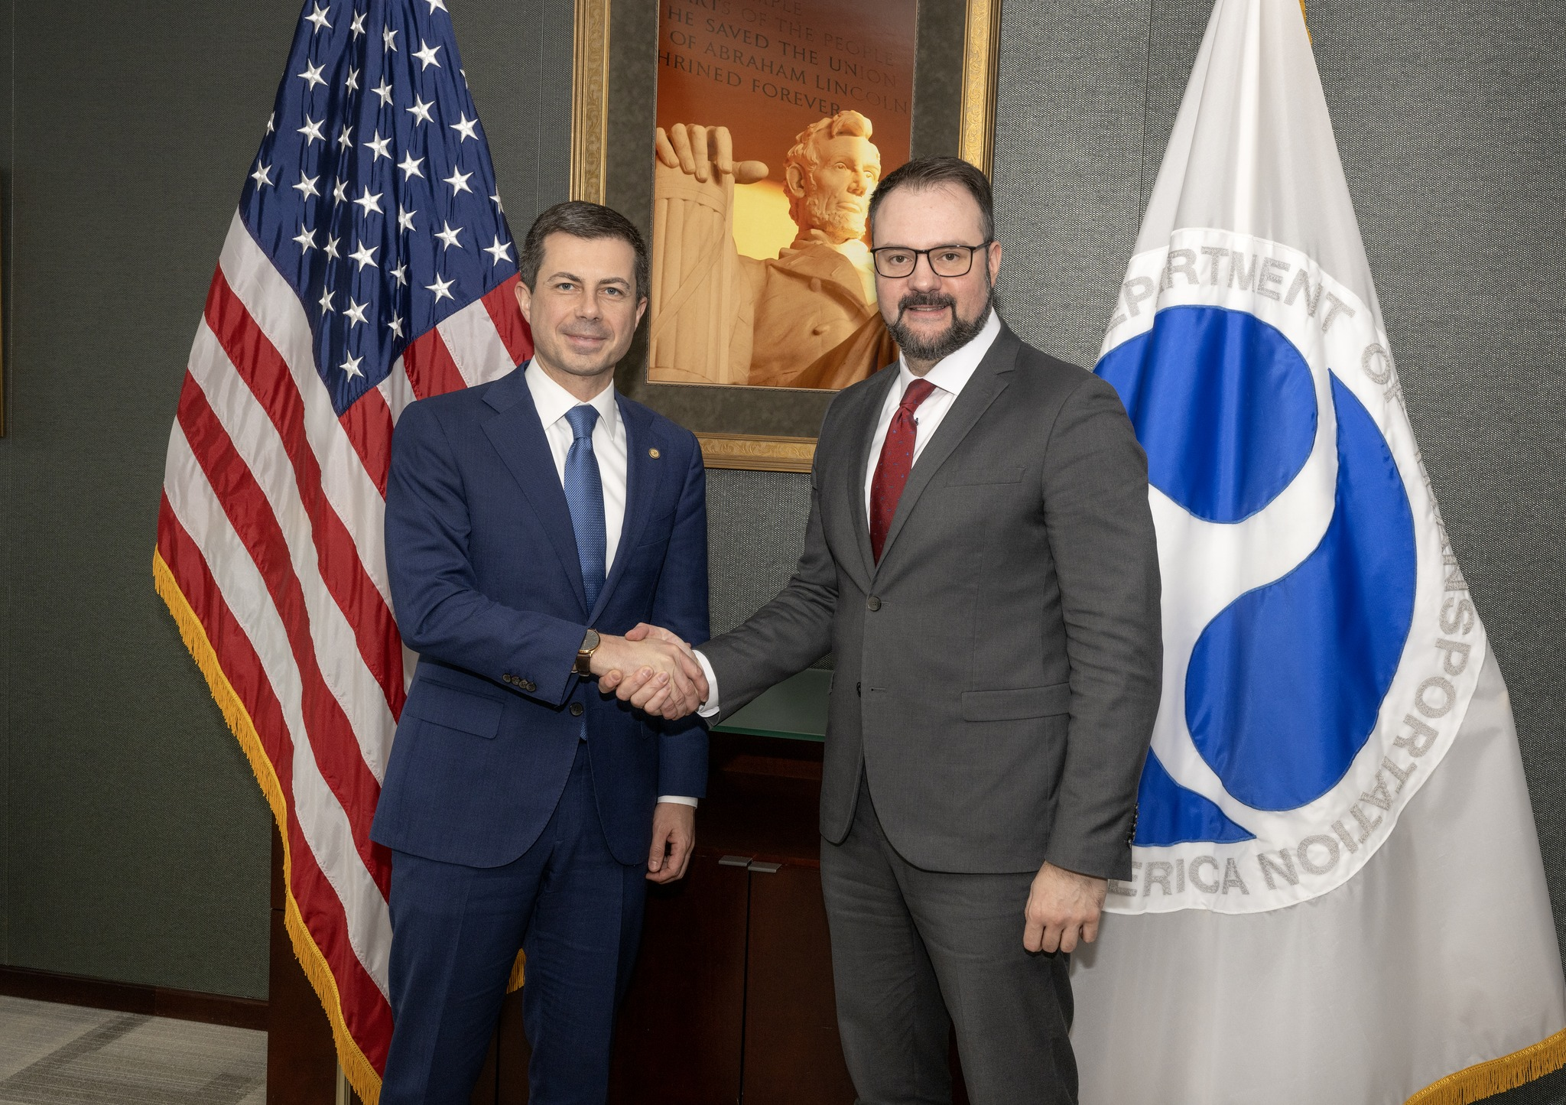
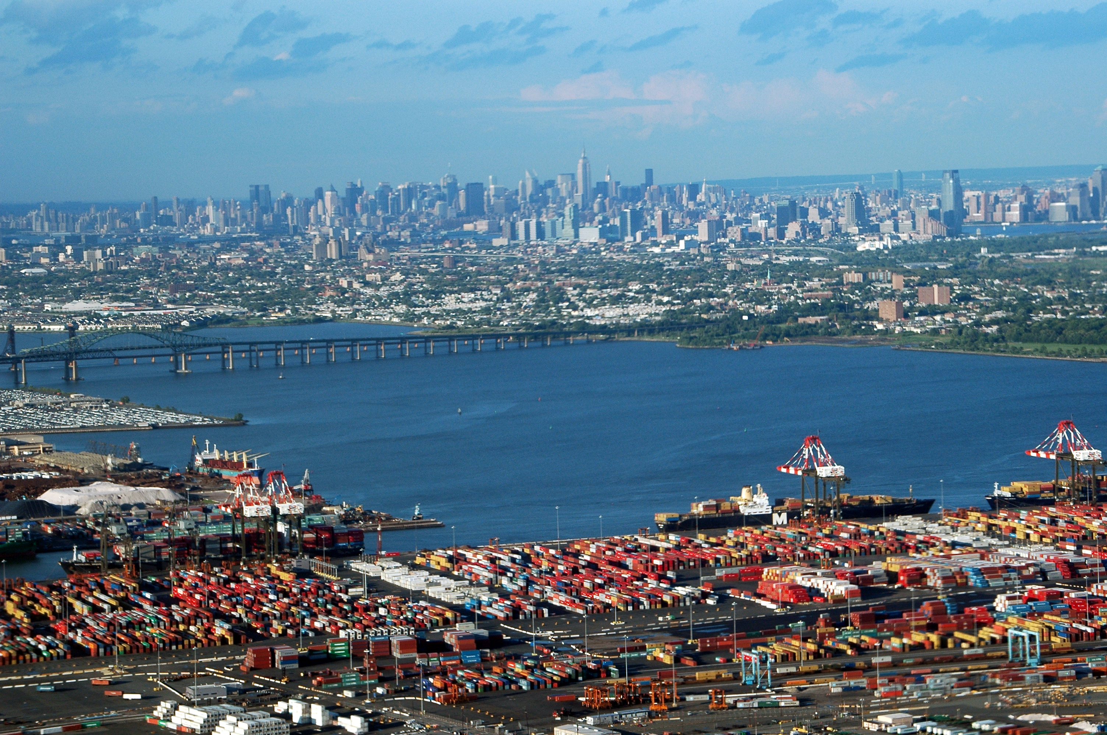
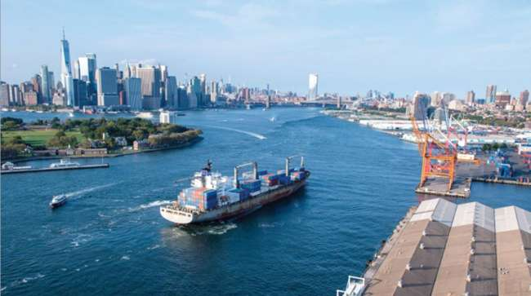
COOPERATION WITH THE UNITED STATES
Notes:
RIX Riga Airport is meeting airlines and inviting carriers to fly to Riga on regular basis as New York is on top of unserved destinations from Riga!
Current passenger/cargo demand is a high risk investment for airlines. Right aircraft type and airline cooperation needed to secure connectivity.
To support the business case, a survey of AMCHAM members is planned in June to identify potential commitment from the business community.

Slide 6
RIGA AIRPORT CITY
Opportunity for private investors!
Investments - EUR 300 million
The project is implemented by Riga Airport in cooperation with an investor selected through a tender process

Slide 7
RIGA AIRPORT CARGO CITY

Slide 8
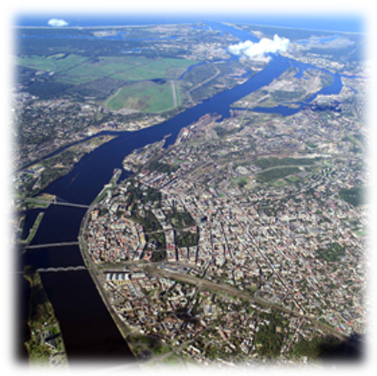
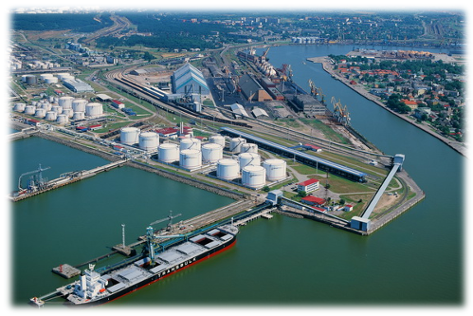
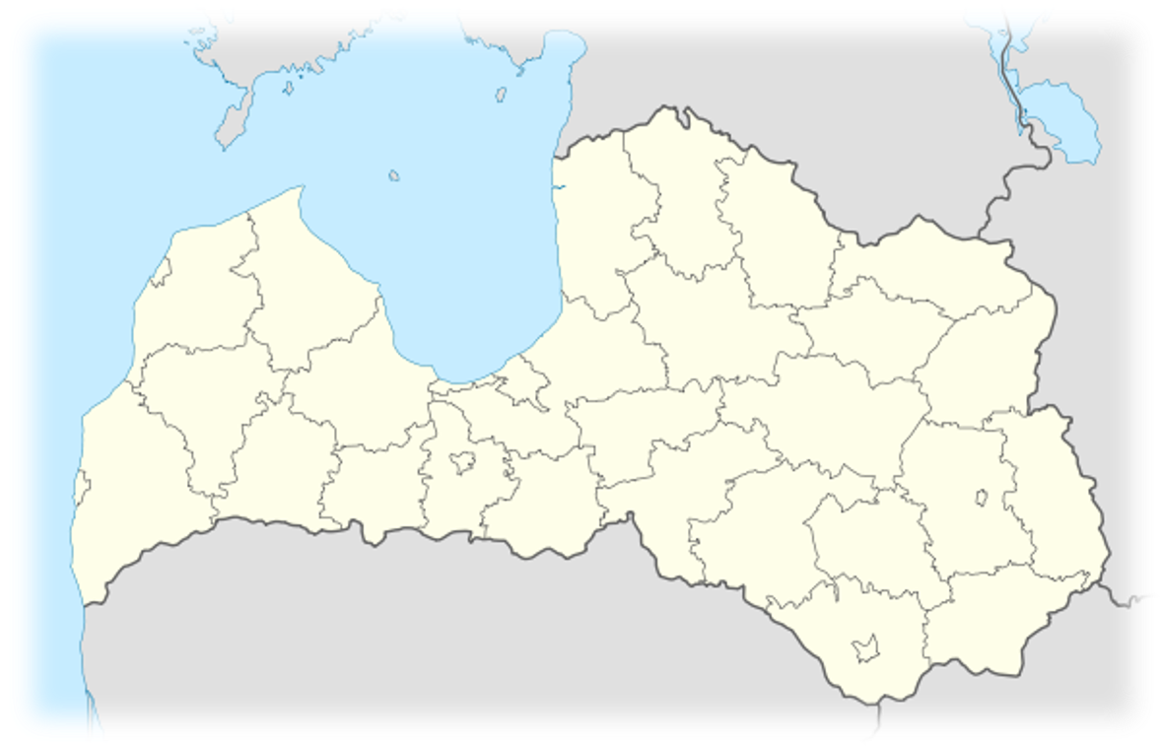
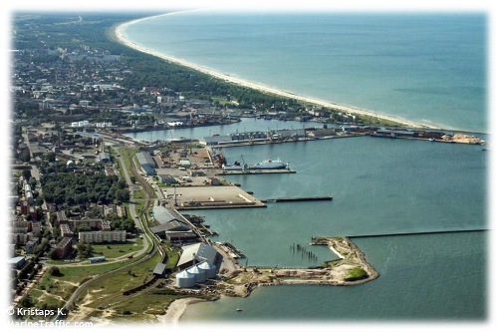
3 BIG ICE FREE PORTS
MULTIPURPOSE PORTS
REGULAR CONTAINER SERVICES
REGULAR RO-RO, RO-PAX FERRIES TO SWEDEN AND GERMANY
TOTAL CAPACITY – 120 MLN.T. / YEAR
TOTAL CONTAINER HANDLING CAPACITY OVER 800 000 TEU / YEAR
DEVELOPMENT TERRITORIES ~ 1315 HA
VENTSPILS
RIGA
LIEPAJA

Slide 9
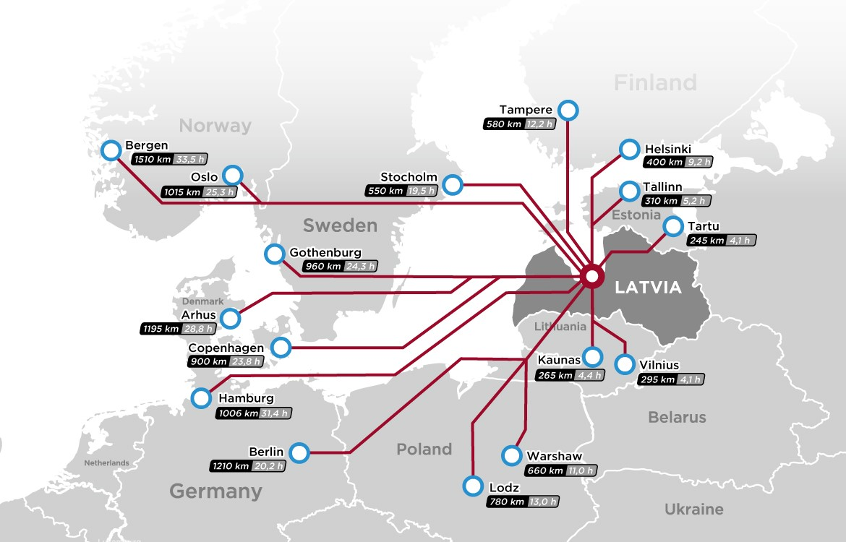
DISTRIBUTION IN NORTHERN EUROPE
IN 48 HOURS TO ALL STORES AND RETAIL CHAINS OF NORTHERN EUROPE
TRANSSHIPMENT
CONSOLIDATION
REPACKING
STORAGE
CUSTOMS FORMALITIES
MONITORING
VALUE ADDED SERVICES

Slide 10
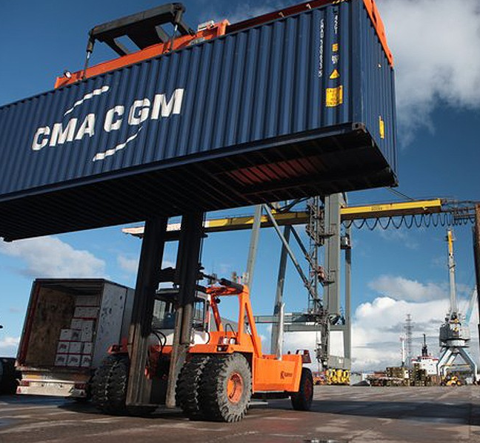
LOGISTICS IN PORTS AND TERMINALS
TRANSSHIPMENT
YEAR-ROUND EASY NAVIGATION
COLD STORAGE WAREHOUSE
DIRECT RAIL-ROAD ACCESS TO THE TERMINALS
EXCELLENT RAILWAY CONNECTIONS TO CENTRAL ASIA
FREEPORT STATUS AND VALUE ADDING POSSIBILITIES
SUBSTANTIAL TAX REDUCTIONS UP TO 55 OF INVESTMENTS MADE
DIRECT TAXES:
INDIRECT TAXES:
Income tax 80%
Real estate duty 80-100%
Value added tax 100%
Excise tax 100%
Customs duty 100%

Slide 11
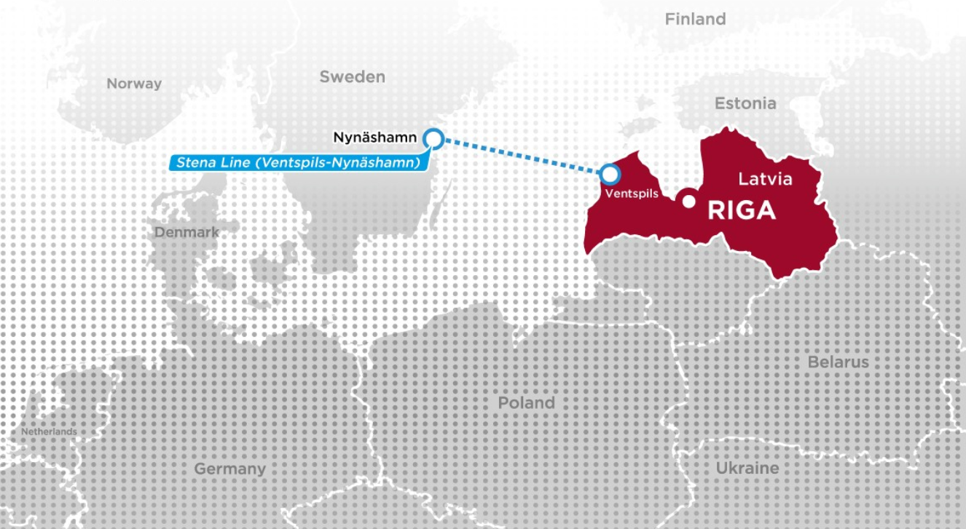
STENA LINE FERRY - OPPORTUNITY FOR LOCAL INDUSTRY
Port of Ventspils - the busiest Latvian Ro-Ro transportation center
8 weekly trips between Nynäshamn and Ventspils in both directions (Stena Line, Ro-Pax)
Nynäshamn (58 km from Stockholm, 545 km from Oslo)
The fastest sea route to connect with Latvia for Stockholm, the central part of Sweden and also the economic activity centers of Norway
Possibility to reach other Baltic countries, Central and Eastern Europe, Ukraine, Centraļ Asia and further regions with the help of land transport.

Slide 12
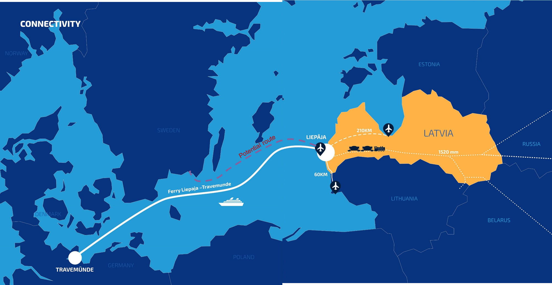
POTENTIAL STENA LINE FERRY ROUTE TO SOUTHERN SWEDEN
LI

Slide 15
5 STRATEGIC PRIORITIES For Shifting Latvia’s Logistics and Transport

Slide 16
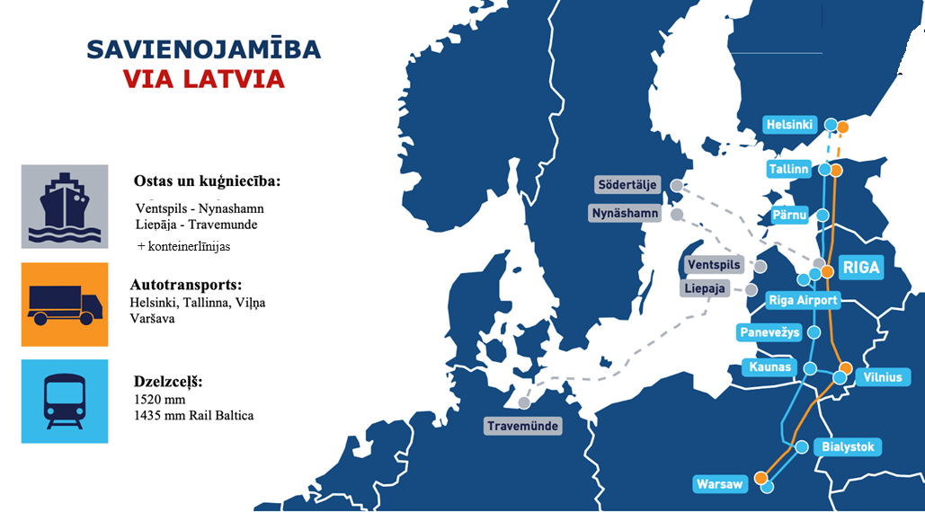
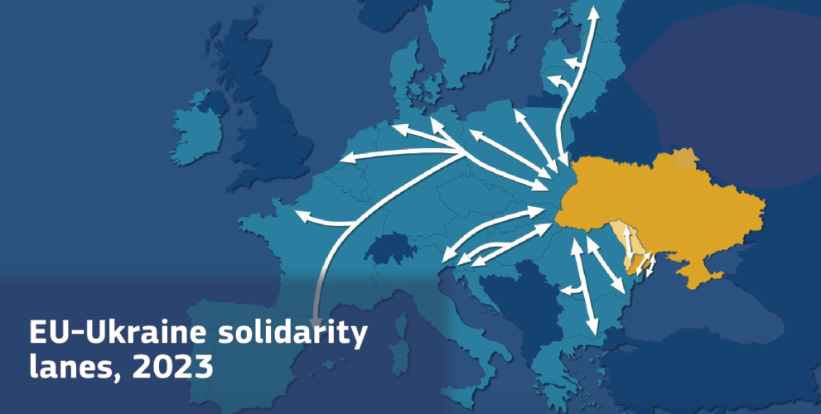
1. CARGO FLOWS AND INVESTMENTS FROM ALLIED COUNTRIES
VIA LATVIA CONNECTIVITY
Far Eastern cargo to Central Europe – an opportunity for Latvian ports to outcompete major European ports (transshipment)
Comparing Hamburg-Prague with Riga-Prague, Latvia has a 300-400 EUR advantage per container.
Supply chains in Central Asia, the Caspian Sea, and the Caucasus region

Slide 17
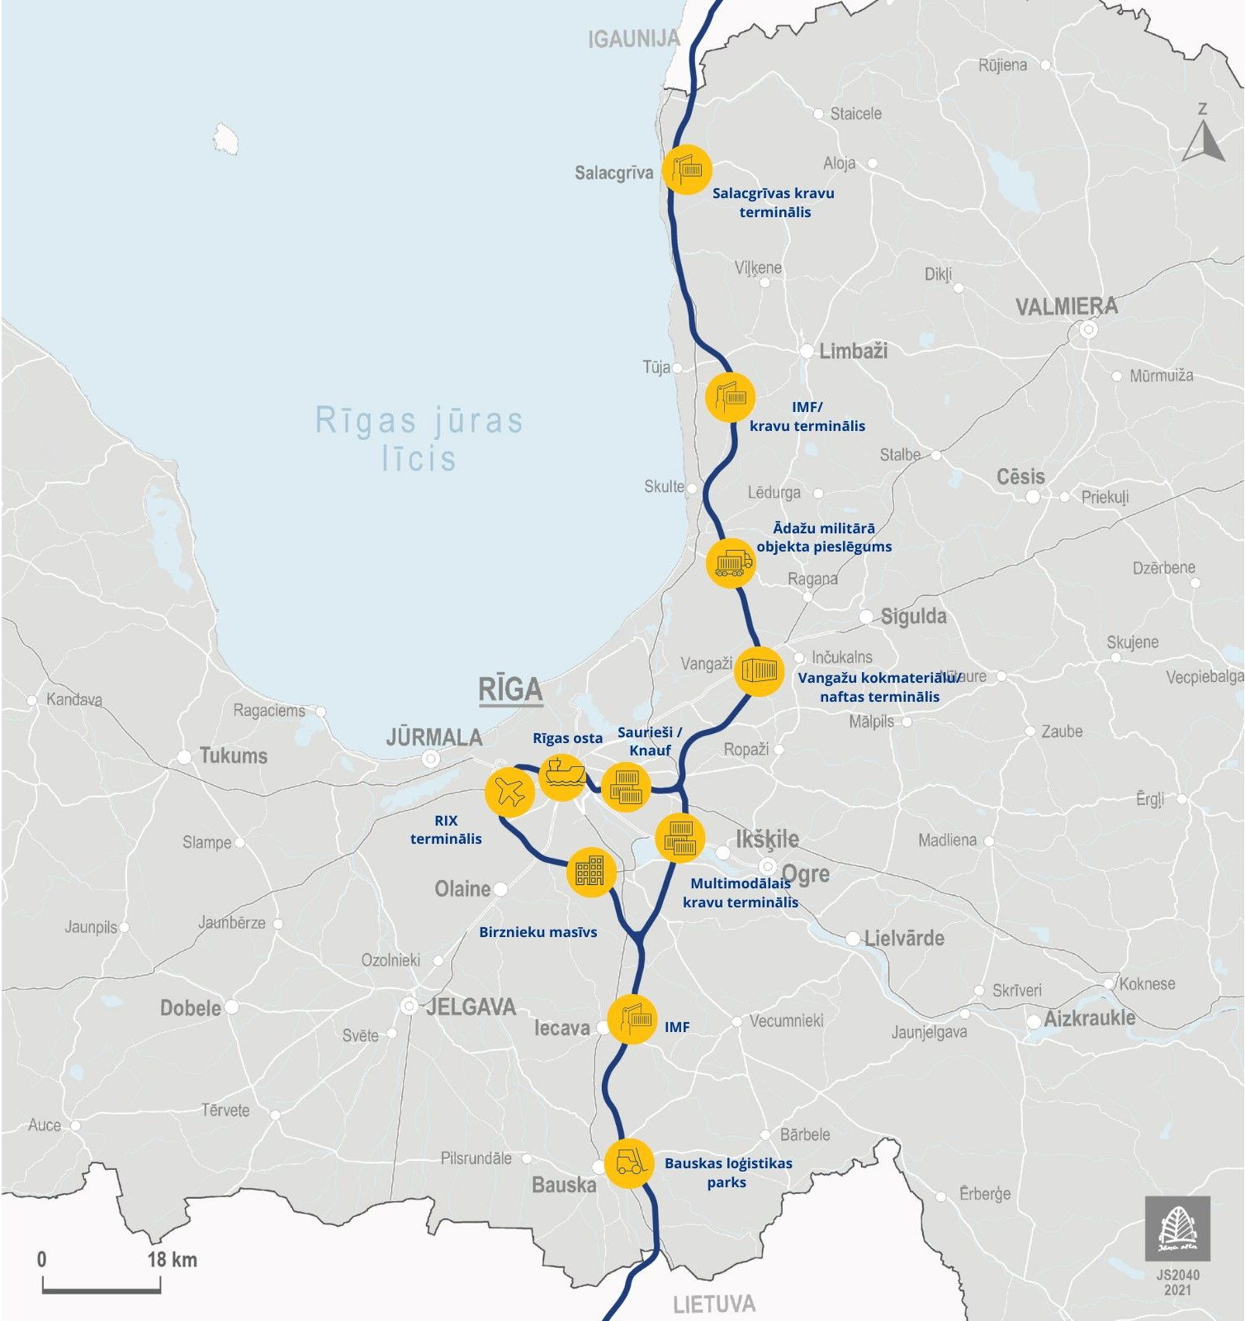
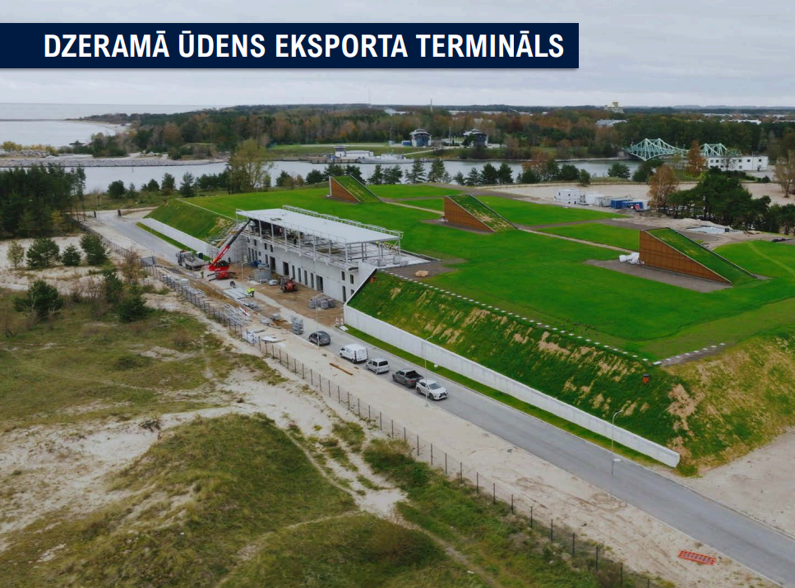
2. LATVIAN EXPORTS AND DOMESTIC TRANSPORT
Shifting domestic cargo from road to rail transport
Investments in the development of industrial parks and domestic terminals
Integration of grain elevators into the railway system
Discussions on transferring wood exports to rail
Redistribution of EU funds for the creation of domestic intermodal terminals
Development projects in port areas to promote exports
Creation of drinking water terminals in Liepaja and Ventspils
Ventspils drinking water terminal
Liepaja drinking water terminal

Slide 18
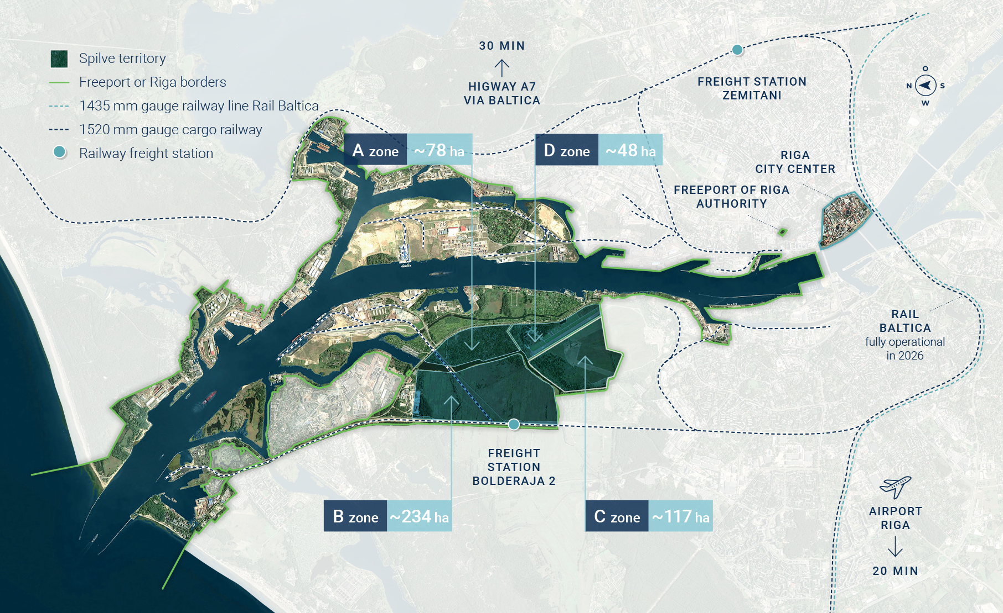
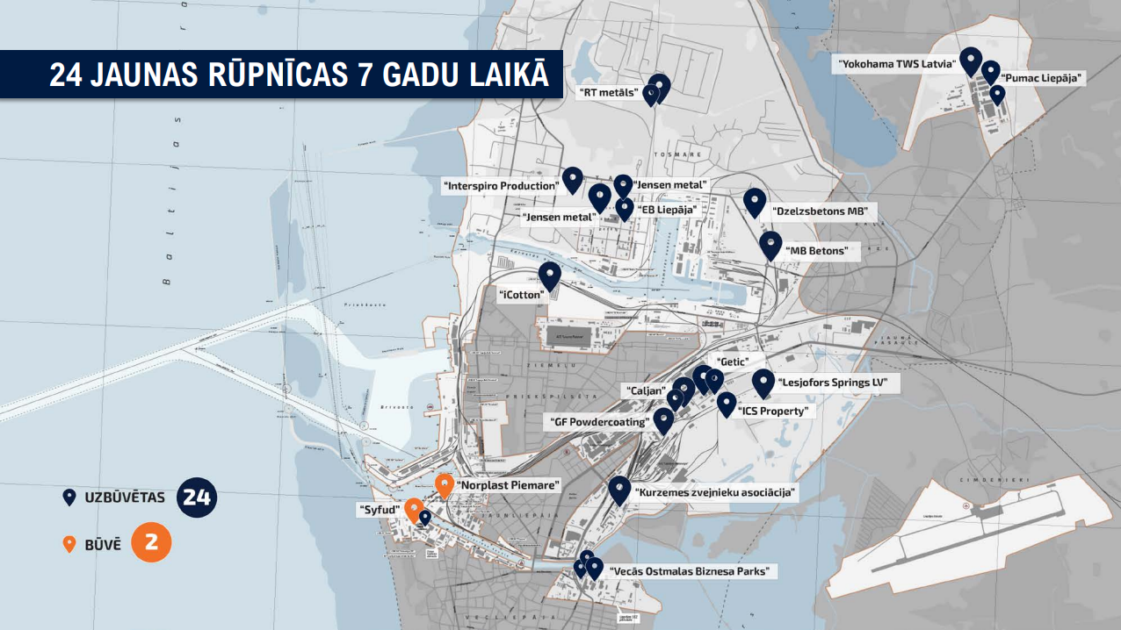
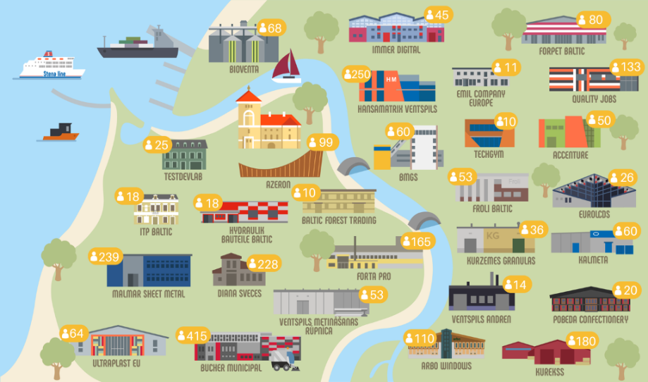
3. INDUSTRIAL DEVELOPMENT IN PORTS/SPECIAL ECONOMIC ZONES
FREEPORT OF RIGA – SPILVE AREA
LIEPAJA – 24 NEW MANUFACTURING SITES IN 7 YEARS
VENTSPILS INDUSTRIAL PARK:
20+ manufacturing sites
2200 jobs

Slide 19
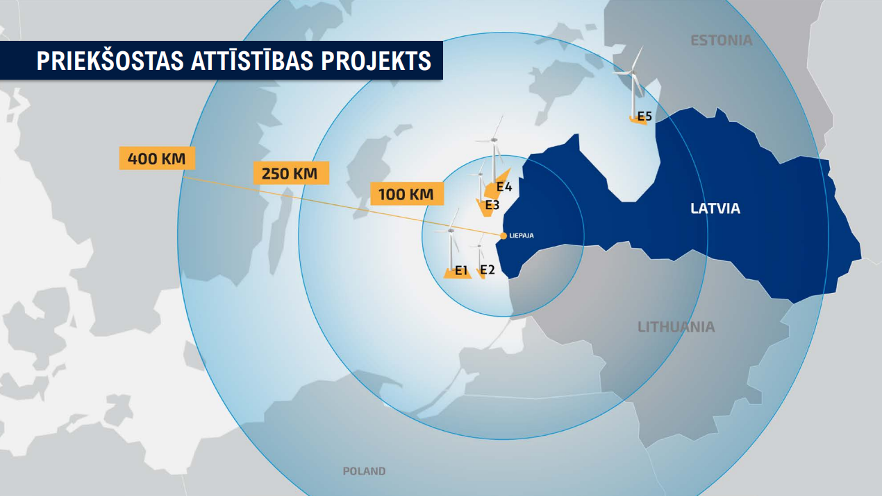
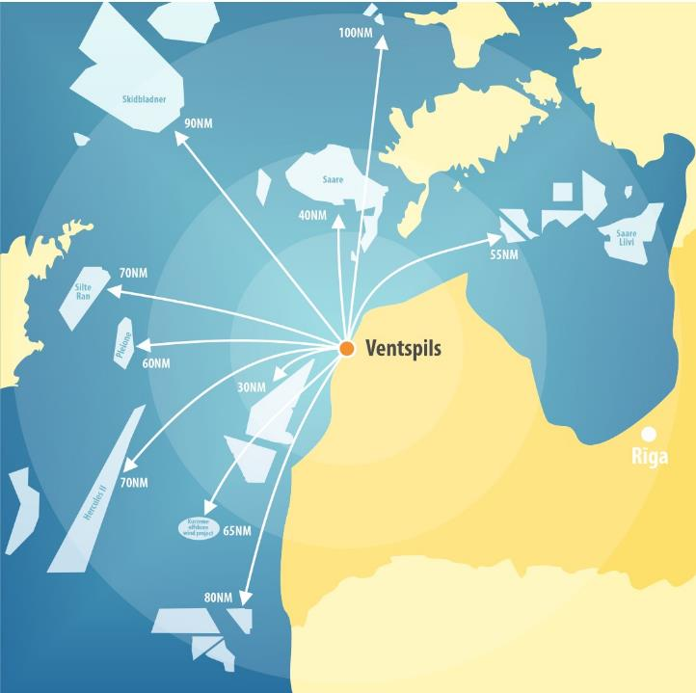
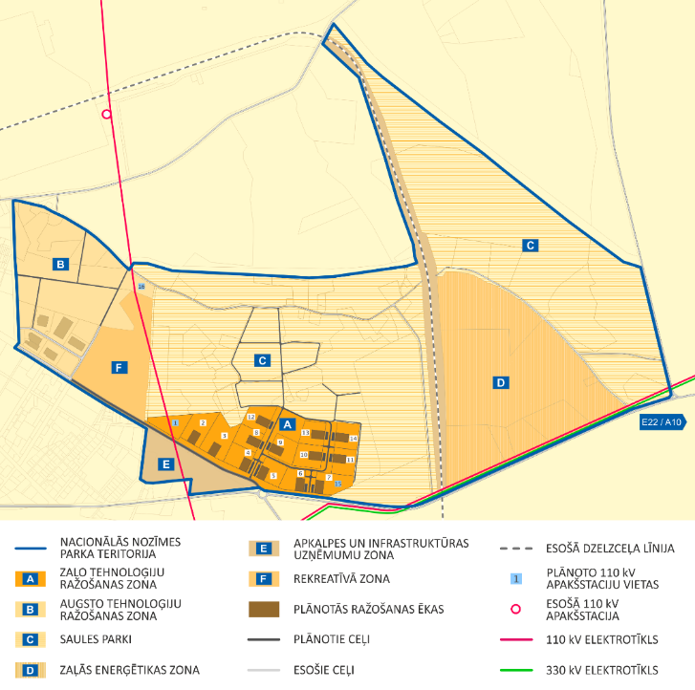
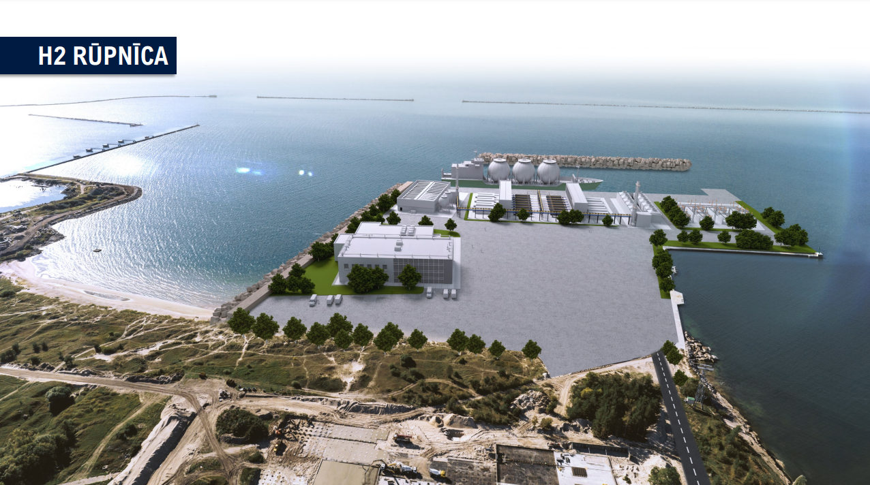
4. RENEWABLE RESOURCE ENERGY PROJECTS
LIEPAJA OFFSHORE WIND PARK BASE
VENTSPILS OFFSHORE WIND PARK BASE
Elwind Latvia project electricity interconnection to Ventspils necessary for the development of the hydrogen economy:
For the storage and transport of green ammonia, e-methanol, and other renewable energy products
LIEPAJA HYDROGEN PLANT

Slide 20
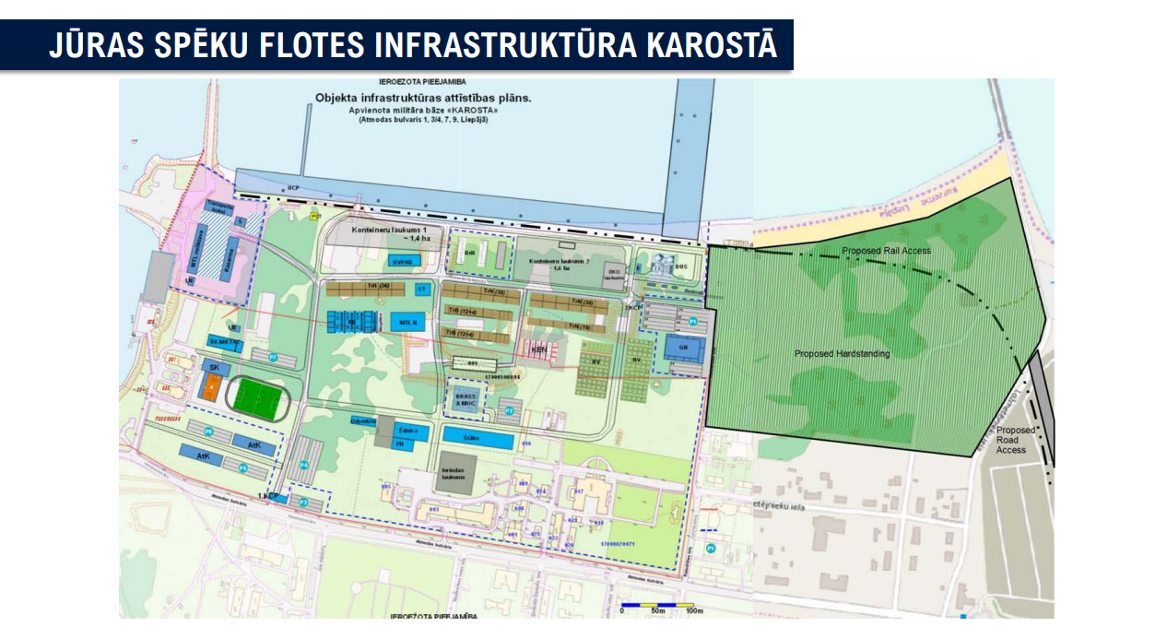
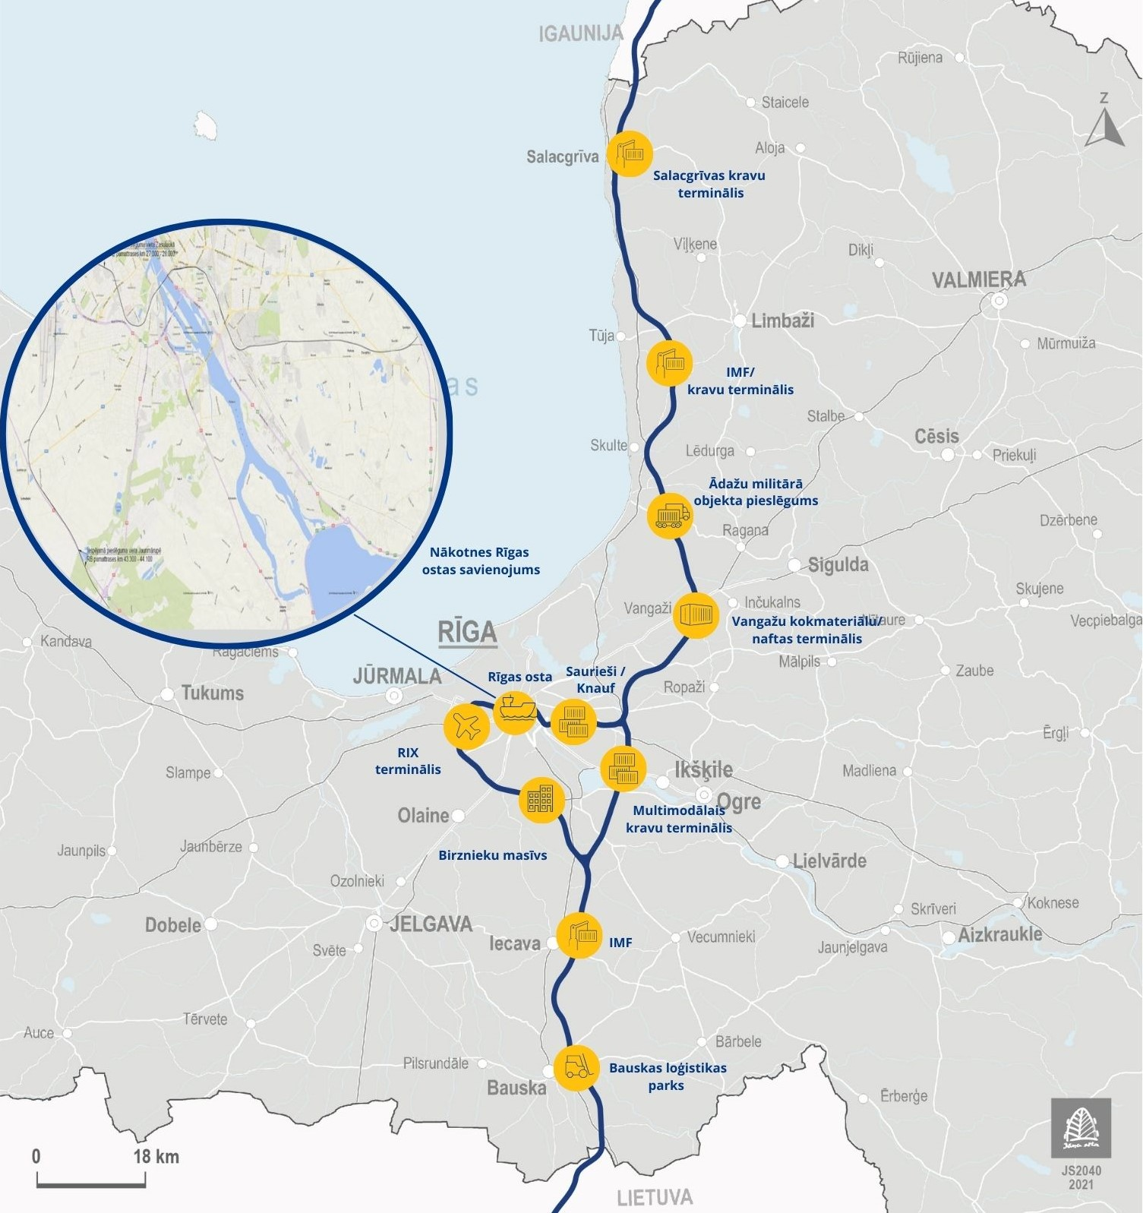
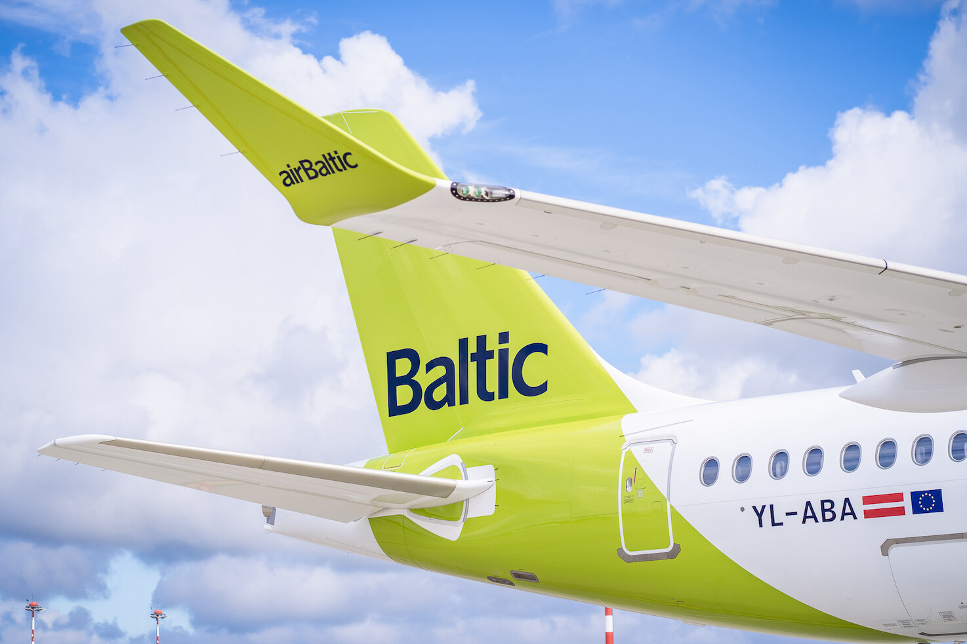
5. MILITARY MOBILITY
NAVAL FORCES FLEET INFRASTRUCTURE IN KAROSTA

