Slide 1
THE MAGIC MIRROR? - professional presence on Facebook

Slide 2
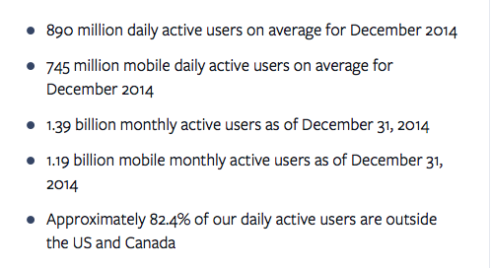
Notes:
202 billion friends request since 2004
More than 6 billion likes per day
7.8 trillion messages send using facebook
Over 25 million SMBs are on facebook

Slide 3
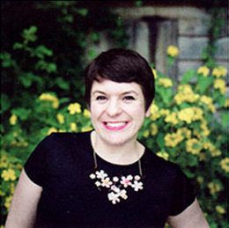
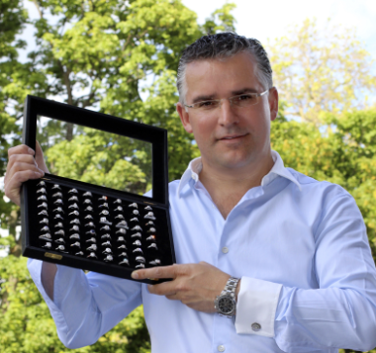
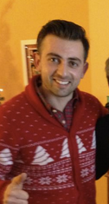
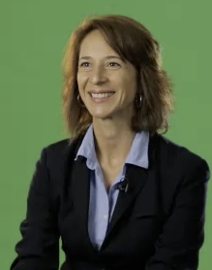
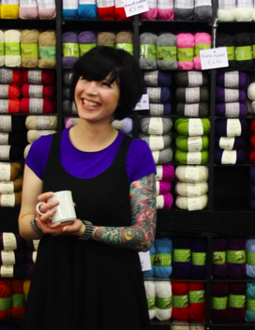
Businesses like yours are using Facebook to find customers and grow sales
61% of MAU in the EU are connected to local business page in EU
270 million views of local business pages in EU/week
8 million comments on local business pages in EU/week
Notes:
There are businesses just like yours using Facebook to grow their business on Facebook.
All EU Member Stats:
· 1.2 billion connections between people and local businesses in the EU (as of 4/1/2013). · 6 in every 10 people on Facebook are connected to at least 1 local business.
· 270 million views of local business pages in the EU in a week (average week between 3/1/2013 and 3/28/2013).
· 8 million comments on local business pages in the EU in a week (average week between 3/1/2013 and 3/28/2013).
Fb App developers in EU: 137464 - 7700 in Estonia

Slide 4
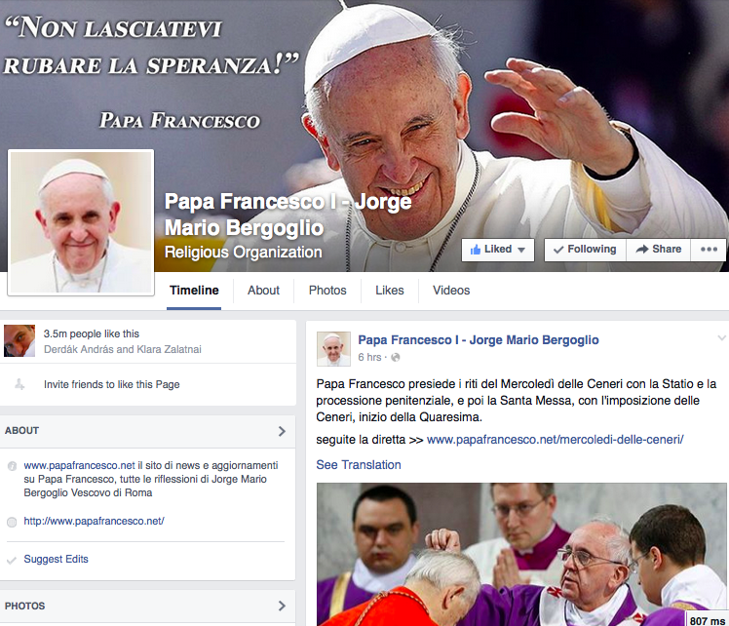
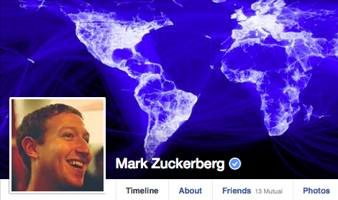
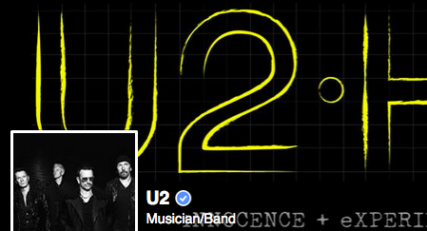
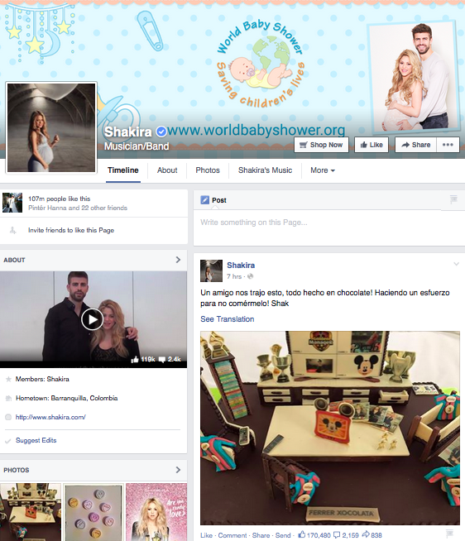
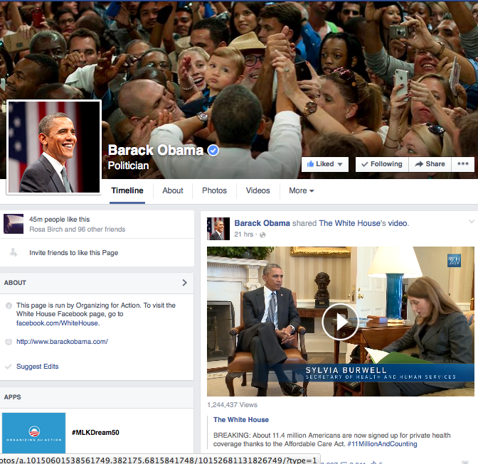
PEOPLE ON FACEBOOK
Notes:
the Pope -3.5 million fans
Shakira - 10.7 million fans
U2 -18m people

Slide 5
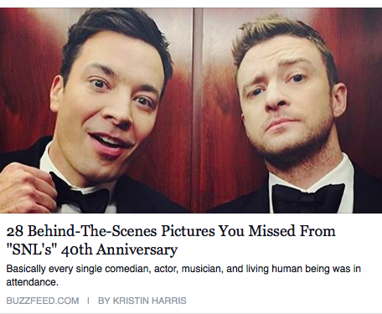
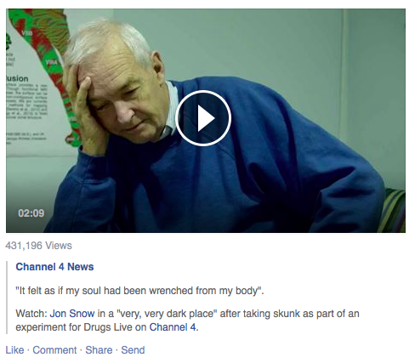
CREATE GREAT CONTENT
Harrison Barnes: “Facebook. That has been the main hub for scavenger hunts and other big contests, and the volume is just higher since there are more fans on there than any other platform. On some posts I get thousands of comments and responses, and Facebook has made hosting Q&A's easier for me. I also like the fact that I can do more long-form content."
MENTIONS APP
BEHIND THE SCENE PHOTOS
NATIVE VIDEOS
Q/A TOOL
TRENDING
Notes:
Award winning English journalist and presenter and Channel 4's longest serving presenter of the News has joined FB and installed Mentions this week. Check out the great native video he's been posting and like him at Jon Snow
First, we’re working with partners to bring great content onto FB. We’ve done this by launching new apps like Mentions which make it easier for public figures to understand the conversation about them and engage with their audience. And we work directly with publishers and content creators to help them understand how best to leverage our platform.
Second, our product team is developing ways to aid discovery and increase engagement around this content both on and off FB. We have built new products like “Trending” which surface the real-time conversation on FB. And we’ve launched a powerful set of APIs which allow digital and TV companies to integrate the conversation on FB into the stories they are telling on the web and on air.
Finally, we’re focused on demonstrating value to partners. For instance, over the past year, we’ve increased referral traffic to news partners by 3x. We’re always listening to feedback on ways we can help drive your business.

Slide 6
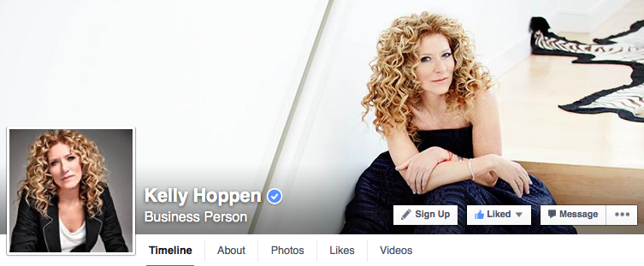
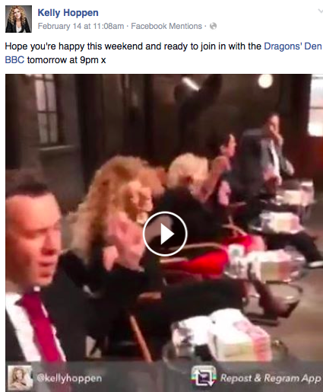
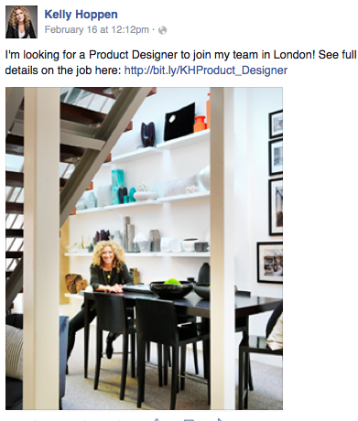
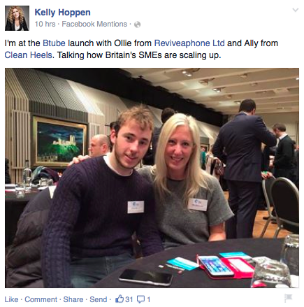
BUSINESS PERSON
Notes:
Kelly Hoppen MBE Interior Designer, Author, Entrepreneur, Dragon BBC Dragons' Den, Creative Director Kelly Hoppen London
USING MENTIONS.APP
USE NATIVE VIDEO
POST TIME SENSSITIVE – FRIDAY WEEKEND MODE
POST PERSONAL – I AM LOOKING FOR…
SHOW YOU CARE FOR THE COMMUNITY – TALKING AT SMB EVENT
USE GREAT PHOTOS

Slide 7
TIPS TO SUCCESS
BE PROFESSIONAL AND BE PERSONAL
THE REAL YOU - BE AUTHENTIC
USE GROUPS FOR DIFFERENT CONVERSATIONS
BUILD COMMUNITY
ENGAGE YOUR FANS
TIME YOUR POSTS
USE PHOTOS AND VIDEOS
KNOW YOUR FANS - USE ANALYTICS

Slide 8
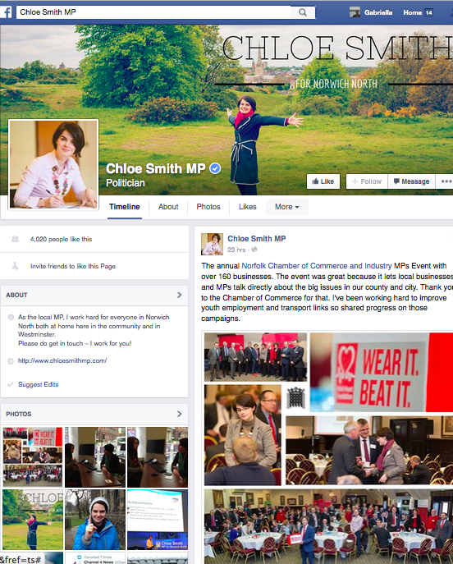
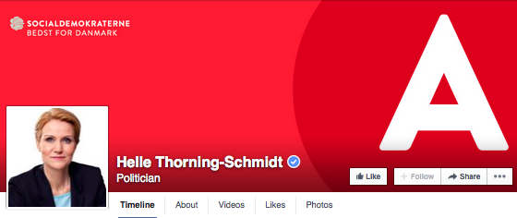
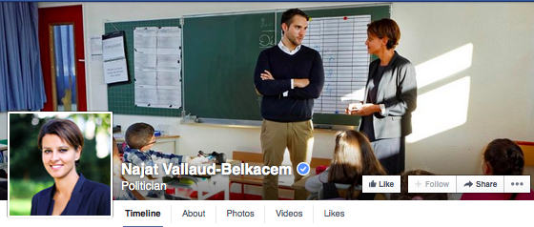
POLITITIANS
Notes:
CHLOE SMITH, MP FOR NORWICH:
“ As the local MP, I work hard for everyone in Norwich North both at home here in the community and in Westminster. Please do get in touch – I work for you!”
NAJAT VALLAUD- BELKACCEM, FRNECH MINISTER OF EDUCATION
HELLE THORNING SCHMIDT, DANISH POLITTIAN

Slide 9
TIPS TO SUCCESS
BREAK THE NEWS
DARE ON CONTENT – LONG POSTS GO
REAL TIME
CONVERSATIONS, ENGAGE YOUR COMMUNITY, ASK THEM TO TAKE ACTION
NOT SO SERIOUS

Slide 10
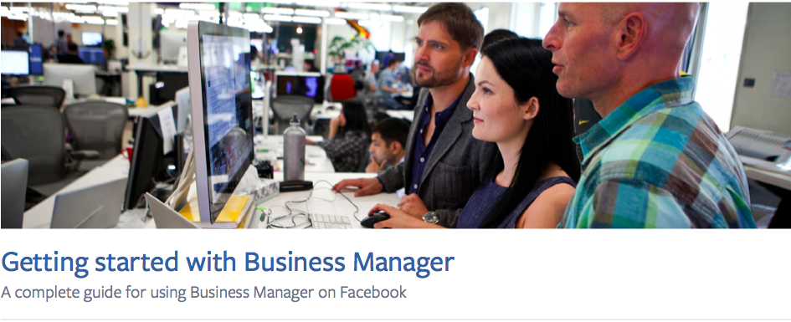
BUSINESS MANAGER
^{business.facebook.com}
Notes:
Business Manager is a solution that provides an easier way for businesses to manage their Facebook Pages, ad accounts, and employee permissions all in one place.
In the past, some businesses have created new Facebook accounts, known as gray accounts or shared accounts, to manage their business’ Facebook Page or run ads. When the account is “shared” with multiple people, tracking changes and managing permission levels becomes challenging.
You should use Business Manager to manage your company’s presence on Facebook if you have multiple ad accounts, have more than 3 Pages, have multiple people who work on your Facebook presence, or if you work with a business partner such as a third-party or agency.

Slide 11
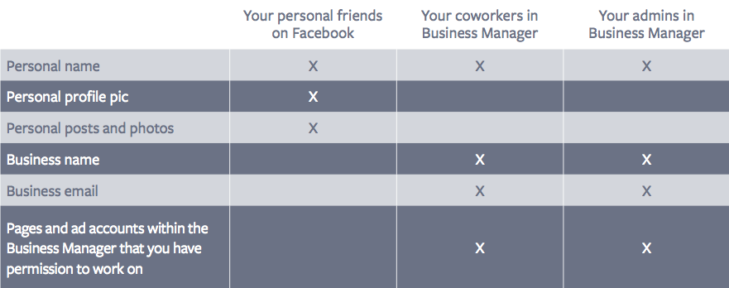
BUSINESS MANAGER VS PERSONAL PROFILE
Notes:
When you set up a Business Manager at business.facebook.com, your business profile will be set as a Business Manager Admin. The admin role lets you control all aspects of the business including modifying or deleting the account, creating Pages and ad accounts, and assigning a team to work on them.
Now, everything can be done using their work email address.
Everything in One Place: Manage all your Facebook Pages and ad accounts in one convenient place -
- Work Faster and Better: Reduce the time it takes to set up and manage your ad accounts and Pages
- Increased Control: Clearly see who has access to your Pages and ad accounts and remove or change their permissions
- Keep Work Separate: You don’t need to be friends with anyone from work to get access to Pages and ad accounts
With Business Manager, you log in once using your personal Facebook details at business.facebook.com and you’ll see all of your ad accounts and Pages in one place.

Slide 12
STAY SAFE
CUSTOMISE YOUR PRIVACY SETTING – CONTACT DETAILS!
CREATE FRIEND LISTS
CUSTOMISE YOUR AUDIENCE
VIEW AS FEATURE
USE ACTIVITY LOG – TIMELINE REVIEW, TAG REVIEW, EDIT PRIVACY, REMOVE AND HIDE POST.

Slide 13
THANK YOU! “Our friendships make the world work”

