Slide 1
Collaboration Between NGOs and Businesses
Inta Šimanska
Latvijas Pilsoniskā alianse
inta@nvo.lv
www.nvo.lv

Slide 2
Overview of NGOs
In total 19255 NGOs, of which 13623 associations and 1044 foundations
On average 30 newcommers (weekly)
Number of NGOs in cities:
Daugavpils – 2,5% or 477 NGOs; Liepaja – 5% or 945 NGOs; Jelgava – 2% or 378 NGOs.
On average there are 8,48 NGOs on 1000 inhab. in one municipality
Data on 3/7/13 with 17 550 NGOs in total

Slide 3
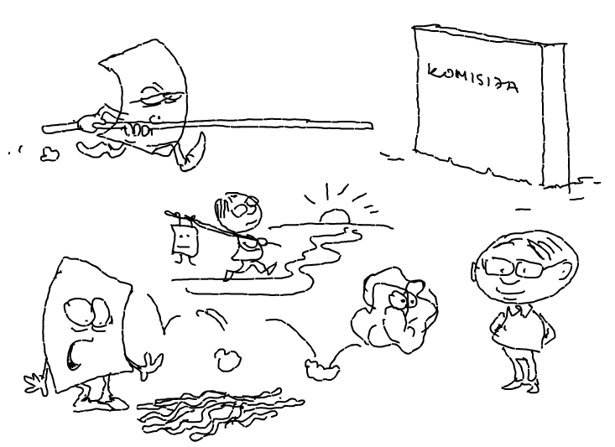
Profile of NGO Activist
Commitment
Urge for changes
49% have a degree of higher education
Woman in her mid 30s

Slide 4
NGO Opinion of Business
Educated best guess and careful assessment
Website
Annual report
Previous experience of others
Rumor

Slide 6
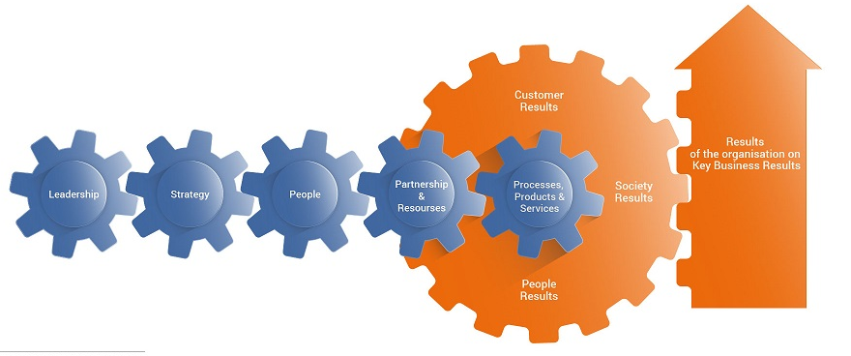
NGO Excellence
Credibility
Accountability
Trust

Slide 7
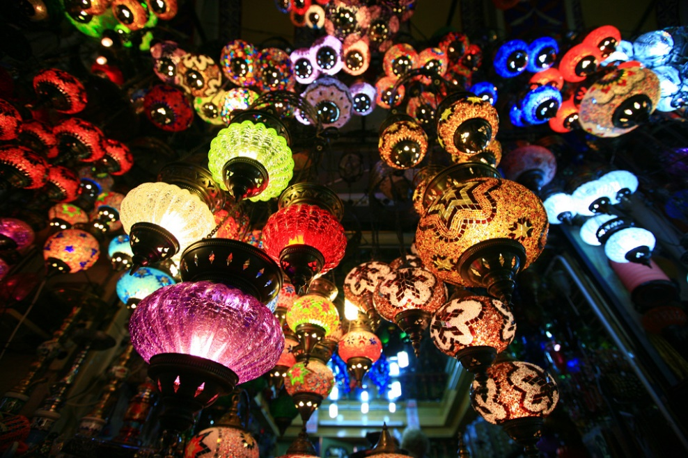
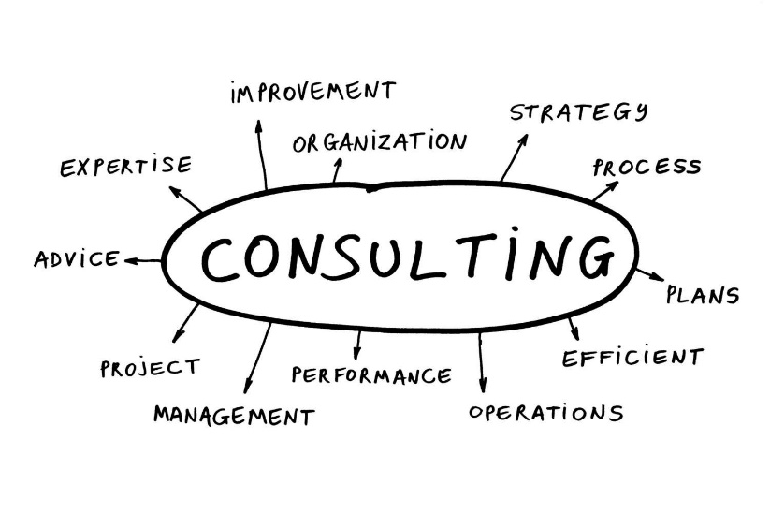
Building and Strengthening Partnerships

Slide 8
What’s in it for NGOs?
Enthusiasm
Strategical and administrative changes
Enabled community
Safer environment

