Slide 1
Specifics of Latvian Insolvency system Case study
Helmuts Jauja Managing Associate, Deloitte Latvia
Riga, 28 November 2013

Slide 2
Case no 1

Slide 3
Case no 1
Vs
SIA “Ceturta planeta”
claim approx. EUR 5 000 000

Slide 4
Case no 1
2009: SIA Ceturta planeta filed for Legal protection proceedings (LPP) and obtained the protection
2010: SIA Ceturta planeta went to insolvency proceedings less than 1 month after commencment of LPP
The insolvency administrator rejected the Bank’s claim
2012: while the Bank was litigating the administrator terminated the insolvency proceedings
2013: The Constitutional court: the problem was in wrong application of the law rather than in rules of the law

Slide 5
Specific details
The LPP was approved by a “last minute” secured creditor
The LPP of SIA Ceturta Planeta was convetred to insolvency proceedings in less then 1 moth after commencment of LPP
The auctions for sale of assets took place in Ventspils on early morning
The assets again under control of debtor’s owners now

Slide 6
Case no 2

Slide 7
Case no 2
VS
SIA Winergy
Claim approx EUR 17 000 000

Slide 8
Case no 2
June 2013: SIA Winergy filed for Legal Protection Proceeding
September 2013: The court rejected the LPP plan
November 2013: SIA Winergy went to insolvency proceeding

Slide 9
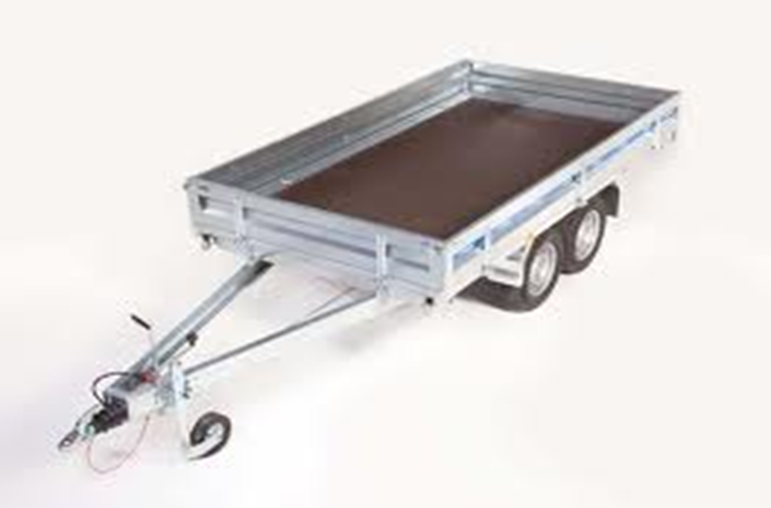
Specific details
Legal address changed before filing for LPP
The LPP approved by a “last minute” secured creditor:
EUR 35 000 000 claim (2/3 of votes)
secured by the pledge on …..
a trailer «Respo»

Slide 10
Specific details 2
Insolvency administrator of LPP reported to the court that LPP plan was sound
SIA Winergy was declared bankrupt because of approx. EUR 5500 claim of related company

Slide 11
Other publicly known cases

Slide 12
Palink
Delfins Partneri
DK Holdings
Tērbatas biznesa centrs

Slide 13
Conclusions

Slide 14
The insolvency system is still dangerous to investments
The main problem: abusive application of the law
Fighting abuse rather than amending the laws

Slide 15
“Deloitte” is the brand under which tens of thousands of dedicated professionals in independent firms throughout the world collaborate to provide audit, consulting, financial advisory, risk management, and tax services to selected clients. These firms are members of Deloitte Touche Tohmatsu Limited (DTTL), a UK private company limited by guarantee. Each member firm provides services in a particular geographic area and is subject to the laws and professional regulations of the particular country or countries in which it operates. DTTL does not itself provide services to clients. DTTL and DTTL member firm are separate and distinct legal entities, which cannot obligate the other entities. DTTL and each DTTL member firm are only liable for their own acts or omissions, and not those of each other. Each of the member firms operates under the names "Deloitte," "Deloitte & Touche," "Deloitte Touche Tohmatsu," or other related names. Each DTTL member firm is structured differently in accordance with national laws, regulations, customary practice, and other factors, and may secure the provision of professional services in their territories through subsidiaries, affiliates, and/or other entities.
Deloitte Central Europe is a regional organization of entities organized under the umbrella of Deloitte Central Europe Holdings Limited, the member firm in Central Europe of Deloitte Touche Tohmatsu Limited. Services are provided by the subsidiaries and affiliates of Deloitte Central Europe Holdings Limited, which are separate and independent legal entities. The subsidiaries and affiliates of Deloitte Central Europe Holdings Limited are among the region’s leading professional services firms, providing services through more than 3,900 people in 34 offices in 17 countries.
Deloitte provides audit, tax, consulting, and financial advisory services to public and private clients spanning multiple industries. With a globally connected network of member firms in more than 150 countries, Deloitte brings world-class capabilities and deep local expertise to help clients succeed wherever they operate. Deloitte's approximately 200,000 professionals are committed to becoming the standard of excellence.
© 2013
Notes:
15

